Slide 1
BANK DATA ANALYSIS REPORT
DATA ANALYST | Nov 2025
TEAM MEMBERS
1.Anilkumar Mallappa Kumbar.
2.Saranya S
3.Yashu Agarwal
4.Sakshi Rajesh Sureban
5.Kaustubh Dhanaji Desai

Slide 2
INTRODUCTION
Domain: Banking
Business Problem: Inefficient loan tracking and lack of insights into repayment behavior, branch performance, and customer demographics.
Goal: Analyze loan data to identify trends, measure performance, and improve financial decision-making for better risk management and revenue growth.

Slide 3
DATA OVERVIEW
Files : Bank Data Analytics.xlsx ,Debit and Credit banking_data.xlsx
Size :~65,000 rows and 25 columns across all files
Key Columns: Account id, Age, BH Name, Bank Name, Branch Name, Caste, Center id, Client Name, close client, closed date, credit officer name, date of birth, dish by, disbursement date(years),gender id, home ownership, loan status ,loan transfer date, next meeting date, product code, grade, subgrade, product ID, purpose category, region name, religion, verification status, state name, transfer logic, is delinquent loan, is default loan, age_T, delinquent 2 years, application type, loan amount, funded amount, amount funded amount inv, term, total payment, total payment inv, total rect prncp, total fees , total rec int, total rec late fee, recoveries, collection recovery fee .Customer ID, Customer name, account number, transaction date, transaction type, amount, balance, description, branch, transaction method, currency, bank name.
Aggregation : Total loan ₹566.88M

Slide 4
OBJECTIVE / KPI'S
BANK DATA ANALYTICS
DEBIT AND CREDIT BANKING DATA
1.Total Loan Amount Funded
2.Total Loan
3.Total Collection
4.Total Interest
5.Branch-Wise Performance
6.State-Wise Loan
7.Religion-Wise Loan
8.Product Group-Wise Loan
9.Disbursement Trend
10.Grade-Wise Loan
11.Default Loan Count
12.Delinquent Client Count
13.Delinquent Loan Rate
14.Default Loan Rate
15.Loan Status-Wise Loan
16.Age Group-Wise Loan
17.Loan Maturity
18.No Verified Loans
1.Total Credit
2.Debit Amount
3.Credit to Debit Ratio
4.Net Transaction Amount
5.Account Activity Ratio
6.ransactions per Day/Week/Month
7.Total Transaction Amount by Branch
8.Transaction Volume by Bank
9.Transaction Method Distribution
10.Branch Transaction Growth
11.High-Risk Transaction Flag
12.Suspicious Transaction Frequency

Slide 5
PROCESS
1. Data Collection
2. Data Cleaning: Handled nulls, removed duplicates, format date values,removed unwanted columns
3. Data Transformation: Created new metrics
4. Visualization: Tableau
5. Insight Extraction

Slide 6

ANALYSIS – BANK DATA ANALYTICS
Loan Amount – ₹566.88M
The total loan disbursed by the bank amounts to ₹566.88 million, showing a strong lending capacity and high customer engagement. This indicates good financial outreach and trust among borrowers.
Total Loans – 49.61K
A total of 49,610 loans have been processed, reflecting a large and diverse customer base. This suggests widespread credit access and an active loan portfolio.
Total Collection – ₹492.94M
The bank successfully collected ₹492.94 million, achieving ~87% recovery of the total loaned amount. This demonstrates effective repayment monitoring and customer discipline.
Total Interest – ₹72.64M
The total interest earned stands at ₹72.64 million, contributing significantly to the bank’s profitability. This reflects sustainable lending practices and interest optimization.

Slide 7
Default Loans – 736
There are 736 defaulted loans, forming 1.48% of the total loan count. This is a manageable default ratio, indicating overall portfolio health and proper risk management.
Delinquent Count – 5,416
5,416 loans are marked as delinquent (missed payments), accounting for 10.92% of the total. This highlights the need for better follow-up strategies and reminders to reduce overdue cases.
Delinquent Rate – 10.92%
A delinquency rate near 11% suggests that a notable segment of borrowers struggle with timely payments. The bank should focus on credit counseling and restructuring options to improve repayment regularity.
Default Loan Rate – 1.484%
The default rate is relatively low, showing that most borrowers eventually repay their dues. This confirms sound credit evaluation and lending decisions by the bank.
Not Verified Loans – 12,310
A total of 12,310 loans remain unverified, which is around 25% of the total loans. This represents a potential data or compliance gap, and verifying these records could strengthen audit readiness and accuracy.

Slide 8
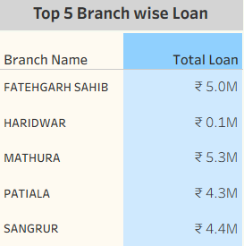
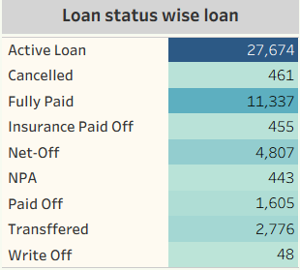
Top 5 Branch-Wise Loan Distribution
Highest loan disbursements observed in Haridwar (₹10.1M) and Mathura (₹5.3M).
These branches contribute majorly to loan portfolios, showing strong customer acquisition and disbursement activity.
Loan Status Analysis
Majority of loans are Active (27,674), followed by Fully Paid (11,337).
This reflects healthy portfolio performance with substantial ongoing and completed loans, ensuring stable revenue flow.

Slide 9
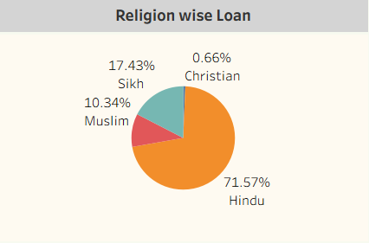
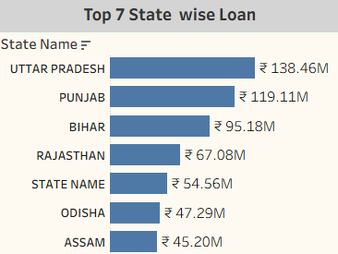
Religion-Wise Loan Distribution
Hindu customers hold the majority (71.57%), followed by Sikh (17.43%) and Muslim (10.34%).
Loan distribution is proportionate to population demographics, suggesting inclusive financial coverage.
State-Wise Loan Analysis
Top Performing States: Uttar Pradesh (₹138.46M), Punjab (₹119.11M), and Bihar (₹95.18M)
Uttar Pradesh leads significantly, highlighting high demand and outreach in North India.

Slide 10
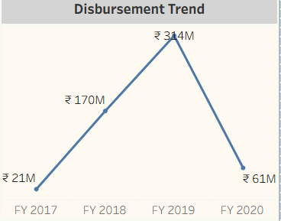
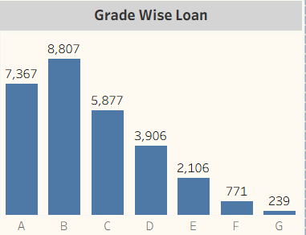
Disbursement Trend
Steady growth from FY2017 (₹21M) to FY2019 (₹341M), followed by a drop in FY2020 (₹61M).
The fall in 2020 may be attributed to economic slowdown or risk-based lending control.
Grade-Wise Loan Distribution
Majority of loans fall under Grade A (8,807) and Grade B (7,367).
Indicates strong borrower creditworthiness and low-risk lending practices.

Slide 11
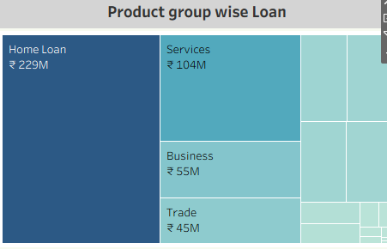
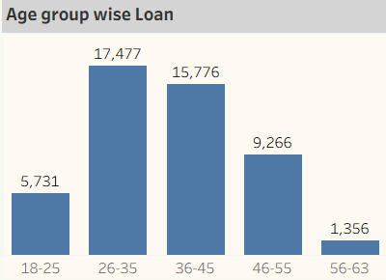
Product Group-Wise Loan
Home Loans (₹229M) dominate, followed by Services (₹104M) and Business Loans (₹55M).
The bank’s focus is on secured and essential financial products, ensuring portfolio stability.
Age-Group-Wise Loan​
26–35 years (17,477) and 36–45 years (15,776) are the most active borrowers.​
Young professionals form the core customer segment, implying long-term engagement potential.

Slide 12
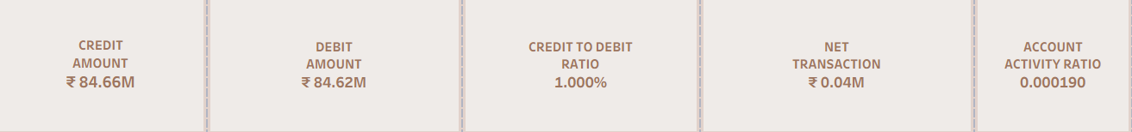
ANALYSIS – CREDIT AND DEBIT ANALYSIS
1. Total Credit & Debit Amount
Both Credit (₹84.66M) and Debit (₹84.62M) amounts are nearly equal, showing a balanced inflow and outflow of funds — a sign of stable liquidity and healthy banking activity.
2. Credit to Debit Ratio
A 1.00 ratio highlights that credits and debits are perfectly balanced, indicating consistent customer transaction behavior without major liquidity fluctuations.
3. Net Transaction Amount
The small positive net value (₹0.04M) reveals slightly higher deposits than withdrawals, suggesting strong fund retention and customer trust in the bank.
4. Account Activity Ratio
An activity ratio of 0.000190 reflects moderate account engagement, implying that while most accounts are active, there’s scope to boost transactional frequency.

Slide 13
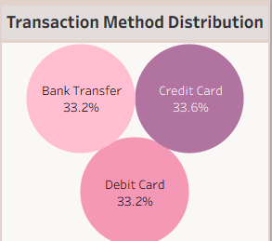
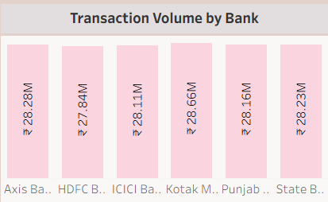
Transaction Method Distribution
The distribution among Credit Card (33.6%), Debit Card (33.2%), and Bank Transfer (33.2%) is evenly split.
This indicates diversified customer preferences and strong adoption of multiple payment channels.
Transaction Volume by Bank
Axis Bank and HDFC Bank lead in total transaction amounts, highlighting customer trust and higher engagement levels in these banks.
Other banks maintain steady participation, contributing to overall balance in activity.

Slide 14
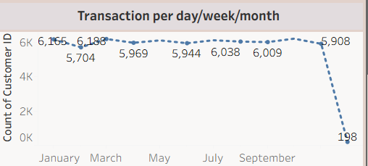
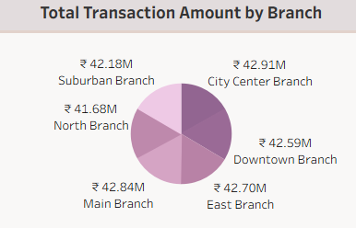
Transactions per Day/Week/Month
From January to November, the transaction volume shows regular fluctuations, indicating consistent customer engagement with occasional ups and downs.
However, from November to December, there is a significant decline in transactions, suggesting a potential slowdown in customer activity .
Total Transaction Amount by Branch
The Main (₹42.84M), East (₹42.70M), and City Center (₹42.91M) branches lead in performance.
Indicates even revenue contribution across major branches and strong branch-level operations.

Slide 15
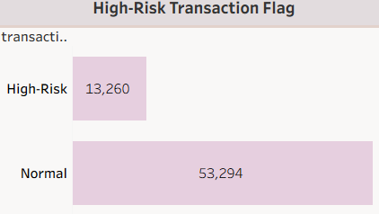
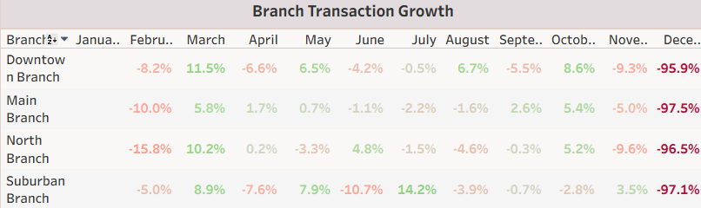
High-Risk Transaction Flag
Out of total transactions, 13,260 are flagged as High-Risk, while 53,294 are normal.
High-risk activity is not dominant but still notable, suggesting a need for continuous fraud monitoring.
Branch Transaction Growth
Main Branch: Grew steadily till August, then declined in Q4 (–97.5%).
Downtown Branch: Moderate fluctuations with similar year-end dip.
Suburban Branch: Shows strongest growth mid-year (+14.2% in July).
Branches perform well during mid-year, but sharp declines in Nov–Dec indicate seasonal or operational slowdown.

Slide 16
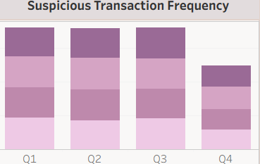
Suspicious Transaction Frequency
Suspicious transactions remain steady across all four quarters (Q1–Q4).
Suggests consistent monitoring and no significant rise in irregular activity, ensuring operational stability.

Slide 17
CHALLENGES FACED
1️. Data Cleaning & Preparation: Faced issues with inconsistent date formats, missing values, and duplicate records, which required manual cleaning before importing into Tableau.
2️ .Data Integration & KPI Calculation: Combining multiple datasets (loan and transaction) and creating calculated KPIs like delinquency rate, credit-to-debit ratio, and account activity ratio required careful formula design and validation.

Slide 18
RECOMMENDATIONS AND INSIGHTS
Balanced Financial Performance: Both loan and transaction data show stable credit–debit flow and consistent disbursement trends, reflecting healthy banking operations and steady customer engagement.
Improvement Opportunities: Slight decline in recent transaction activity and moderate account engagement indicate scope for boosting customer retention through targeted offers, digital campaigns, or loyalty programs.

Slide 19
CONCLUSIONS
✅ The dashboard highlights balanced credit–debit activity and steady loan disbursements but reveals seasonal dips and rising delinquency risks.
✅ Strengthening customer engagement and tightening credit monitoring can enhance overall financial performance and portfolio stability.

Slide 20
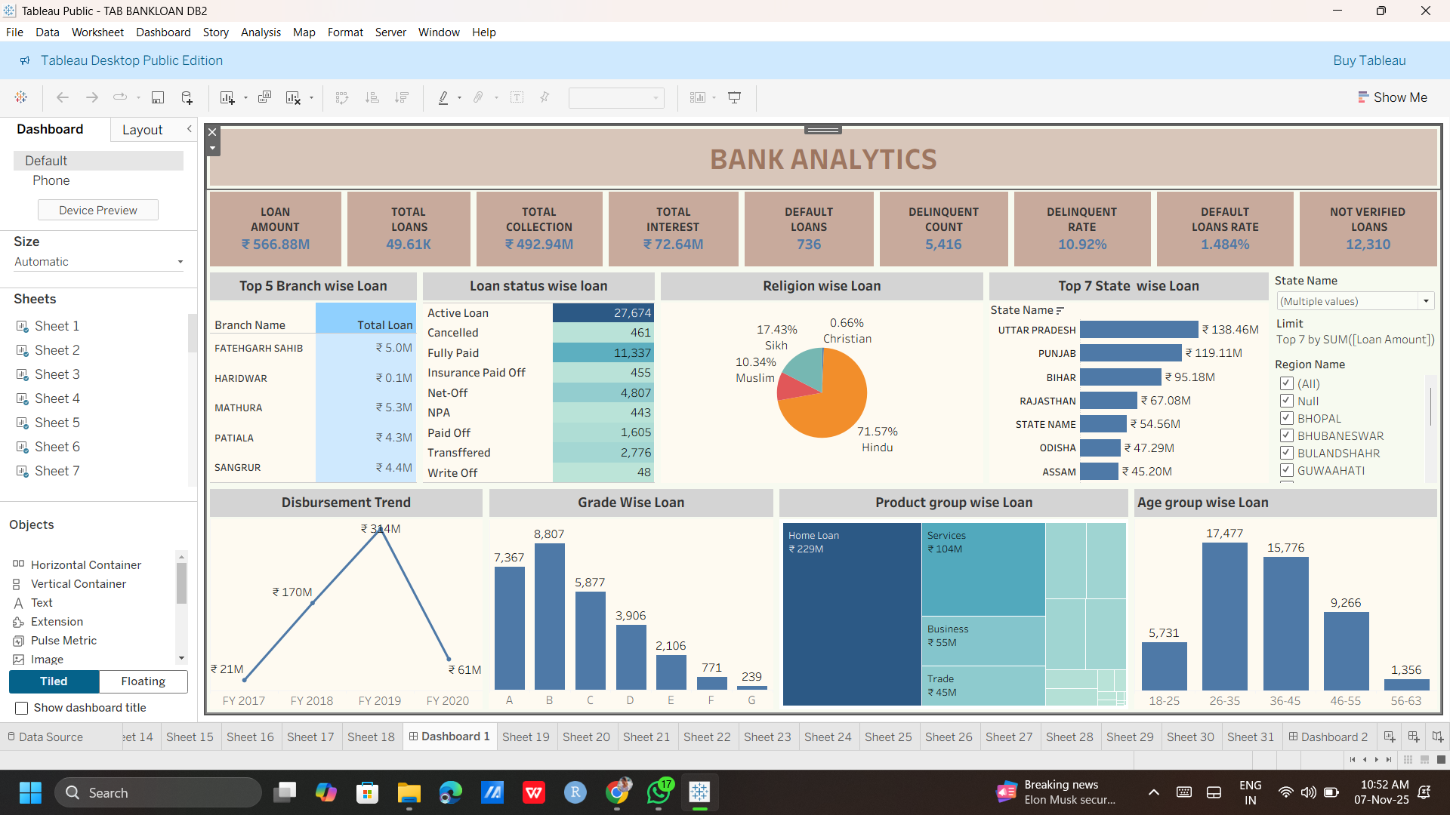
DASHBOARD SNAPSHOT

Slide 21
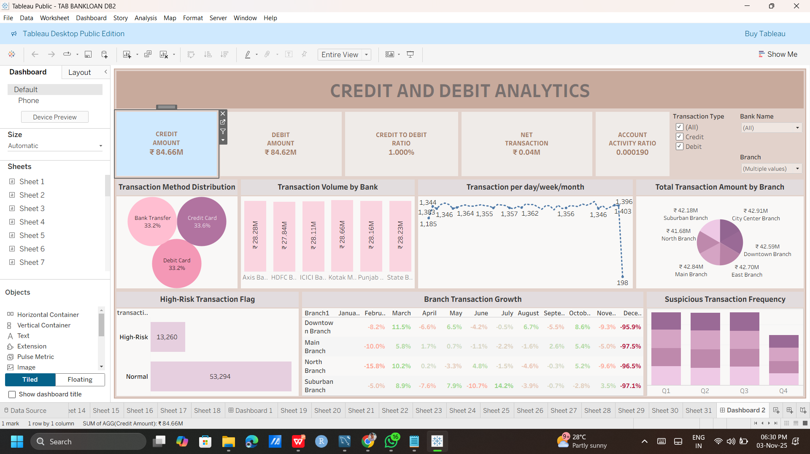

Slide 22
THANK YOU

